Slide 2
Discussion sections

Slide 3
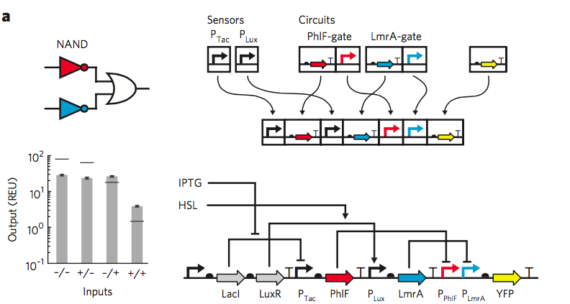
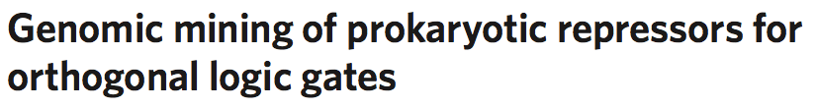
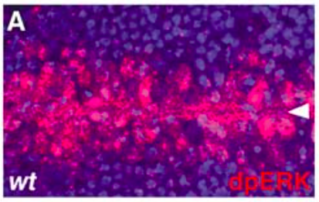
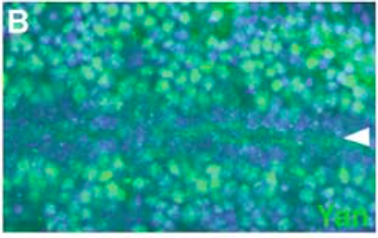

Stanton et al. (2014) covered lectures on:
Computability
Constraints imposed by the parts in biological systems
Melen et al. (2005) covered lectures on:
Signaling (snow day)
Inhibition and cooperativity
Ultrasensitivity

Slide 4
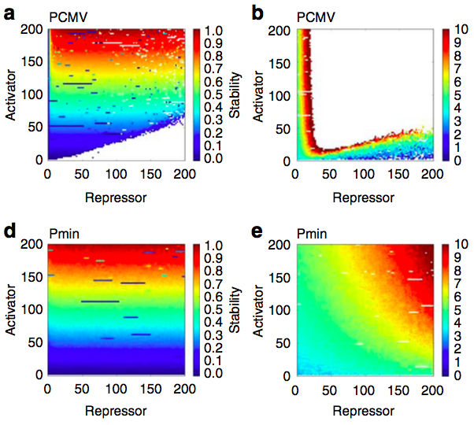

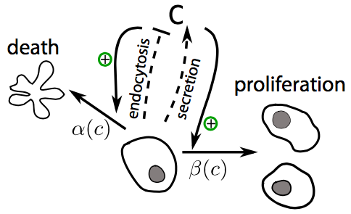
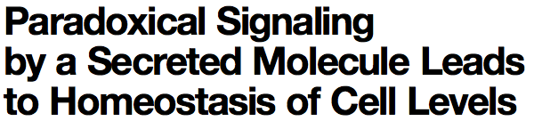
Lebar et al. (2014) covered lectures on:
Phase plane analysis
Bistability
Genetic switches
Hart et al. (2014) covered lectures on:
Motif enrichment
Introduction to control theory

Slide 5
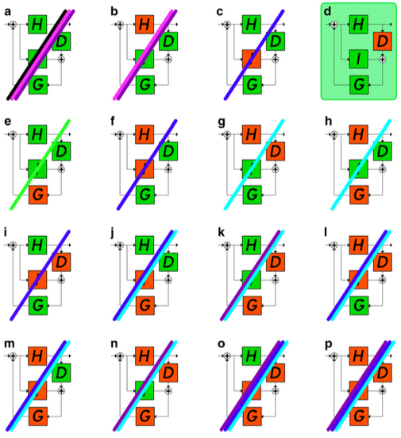

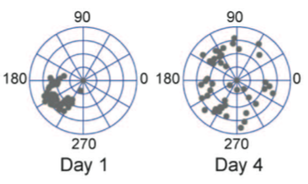

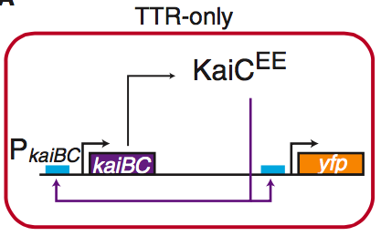
Muzzey et al. (2009) covered lectures on:
Derivative and integral control
Frequency response analysis
Teng et al. (2013) covered lectures on:
Cyanobacterial circadian clock
Smooth vs. relaxed oscillators
Synthetic oscillators

Slide 6
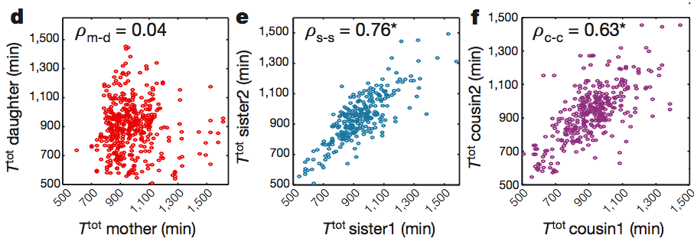
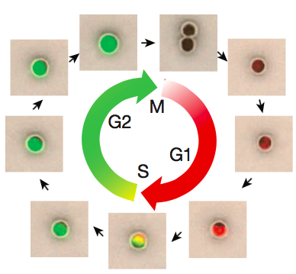

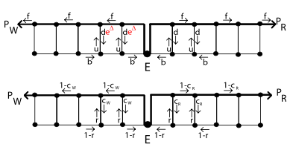
Sandler et al. (2015) covered lectures on:
Oscillations
Stochastic processes
Murugan et al. (2012) covered lectures on:
Kinetic proofreading

Slide 7
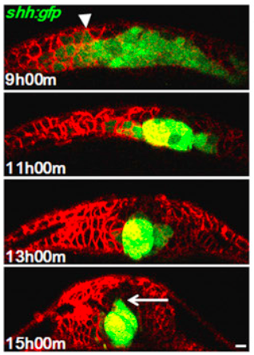

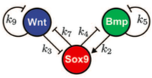
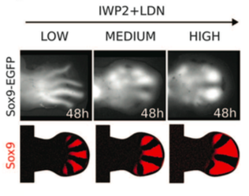
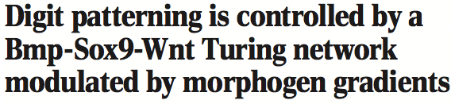
Xiong et al. (2013) covered lectures on:
Stochastic processes
Axial patterning
Error correction during development
Raspopovic et al. (2014) covered lectures on:
Axial patterning (incl. reaction-diffusion systems)
Turing patterns

Slide 8
Problem sets

Slide 9
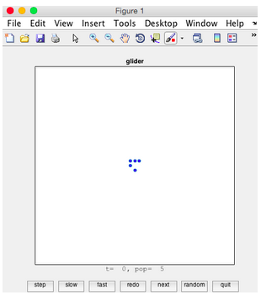

Problem set 0 (optional): Game of Life
Problem set 1: logic gates, modeling

Slide 10

Problem set 2: inhibition and cooperativitiy
Problem set 3: ultrasensitivity, Boolean logic circuits, linear systems

Slide 11
Problem set 4: nonlinear systems, Laplace transforms
Problem set 5: network architecture, negative autoregulation

Slide 12

Problem set 6: network motifs, integral and derivative control, oscillations
Problem set 7: Circadian rhythms, stochastic processes

Slide 13



Problem set 8: diffusion, SDEs, Fokker-Planck equation
Problem set 9: axial patterning, error correction, Turing patterns

Slide 14
Textbooks and optional readings

Slide 15
Lecture slides and notes

Slide 16
Lectures

Slide 17
Final project

